Slide 1
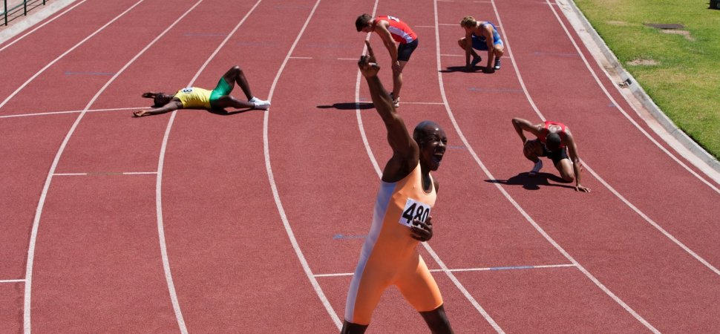
Be Persevering
2 Timothy
Dr. Rick Griffith • Crossroads International Church Singapore
BibleStudyDownloads.org

Slide 2

Many who followed Jesus…

Slide 3
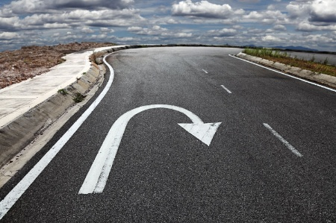
…don’t follow him today.

Slide 4

Apostasy.
“a turning away by rejecting”
Notes:
This is called “apostasy.” It literally means a turning away by rejecting.
Sometimes this means that the person no longer claims to be a Christian—but in other cases, the person still claims the name of Jesus (professes Christ) but has turned away from a key doctrine of the faith.

Slide 5
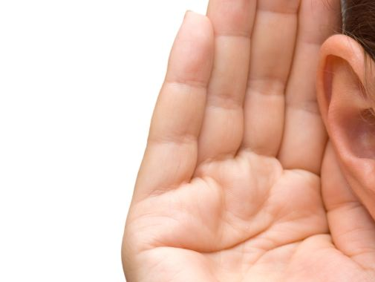
"For a time is coming when people will no longer listen to sound and wholesome teaching. They will follow their own desires and will look for teachers who will tell them whatever their itching ears want to hear. ⁴ They will reject the truth and chase after myths" (2 Timothy 4:3-4 NLT).
They will “turn away their ears (apostrepho) from the truth"
(2 Timothy 4:4 NAU).

Slide 6
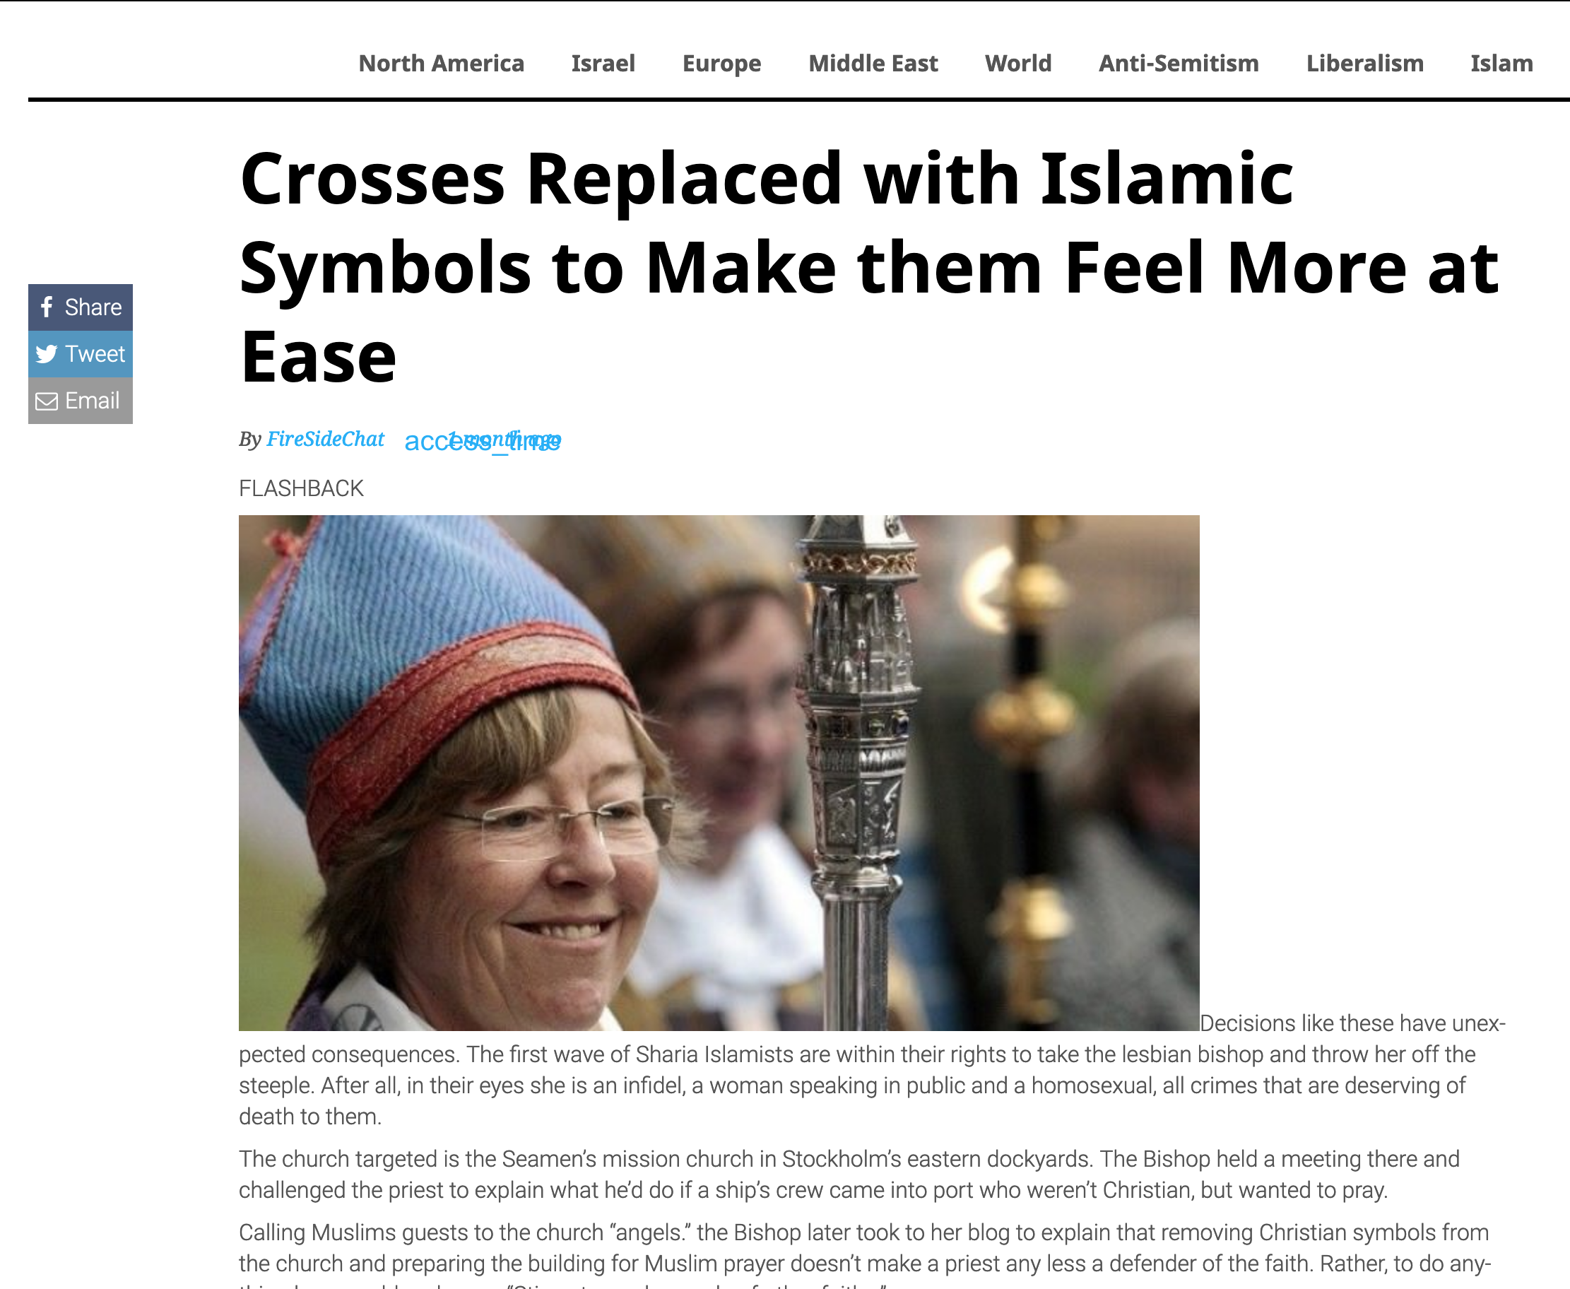
Crosses Replaced with Islamic Symbols to Make them Feel More at Ease
22 August 2019
Notes:
First Lesbian Bishop Orders Crosses Replaced with Islamic Symbols to Make them Feel More at Ease
________
https://www.firesidechat.news/2019/08/22/first-lesbian-bishop-orders-church-crosses-replaced-with-islamic-symbols-to-make-them-feel-more-at-ease.html
__________________
The Great Apostasy
Posted On January 5th, 2015
AKA: The Great Falling Away
https://www.prophecyindex.org/prophecies/view/the_great_apostasy/

Slide 7
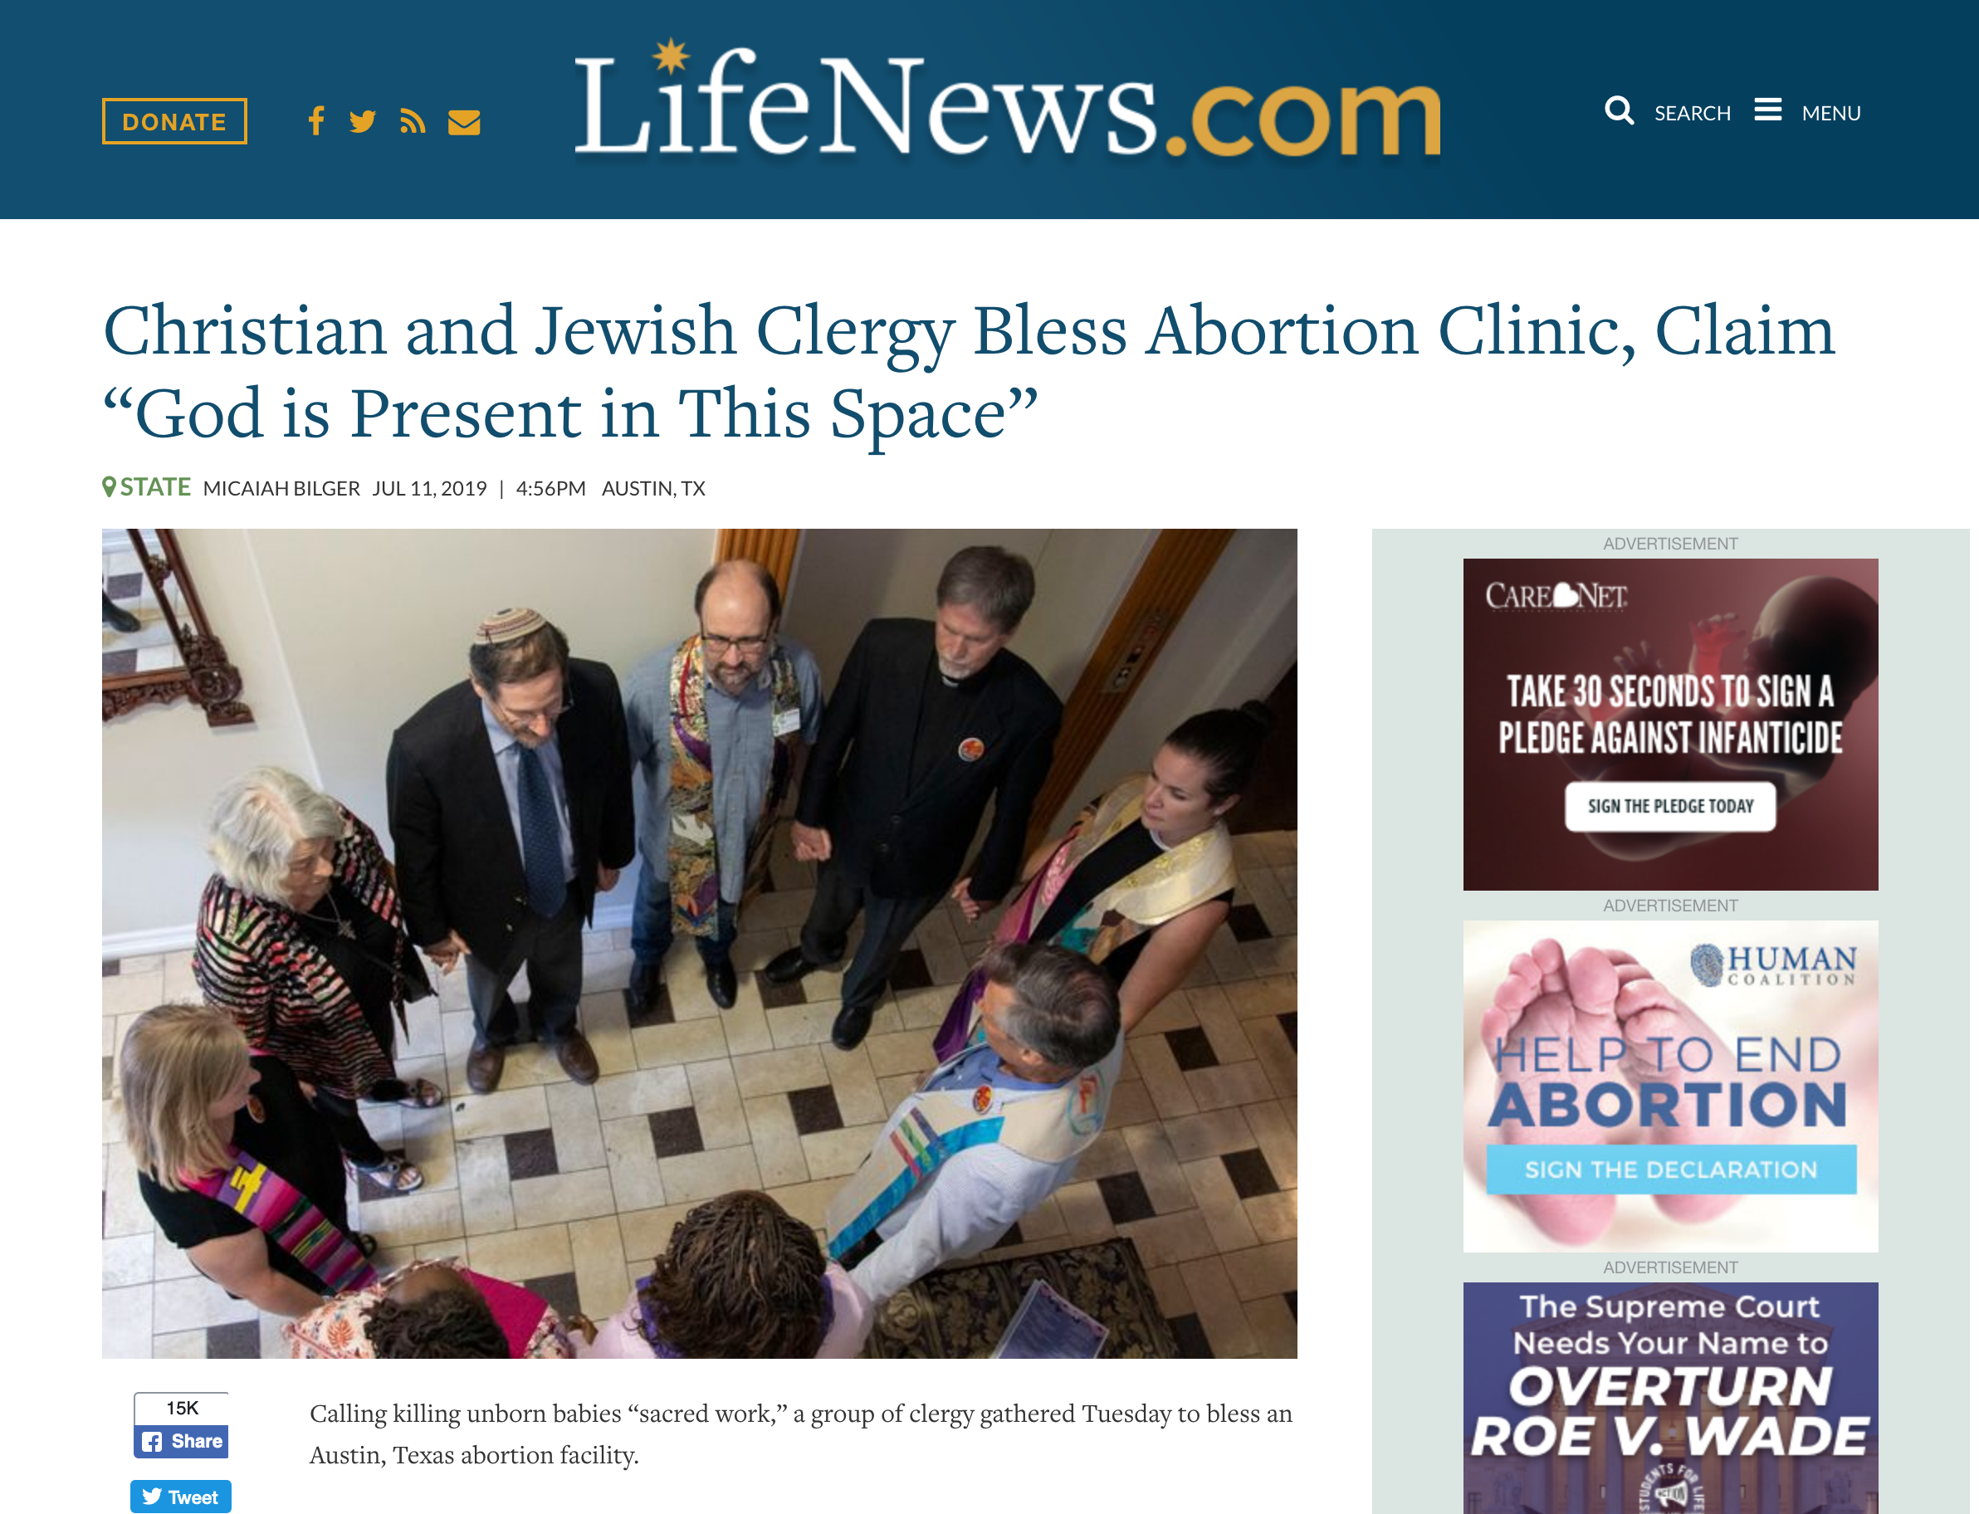
Christian and Jewish Clergy Bless Abortion Clinic,
Claim “God is Present in This Space”
Notes:
https://www.lifenews.com/2019/07/11/christian-and-jewish-clergy-bless-abortion-clinic-claim-god-is-present-in-this-space/

Slide 8
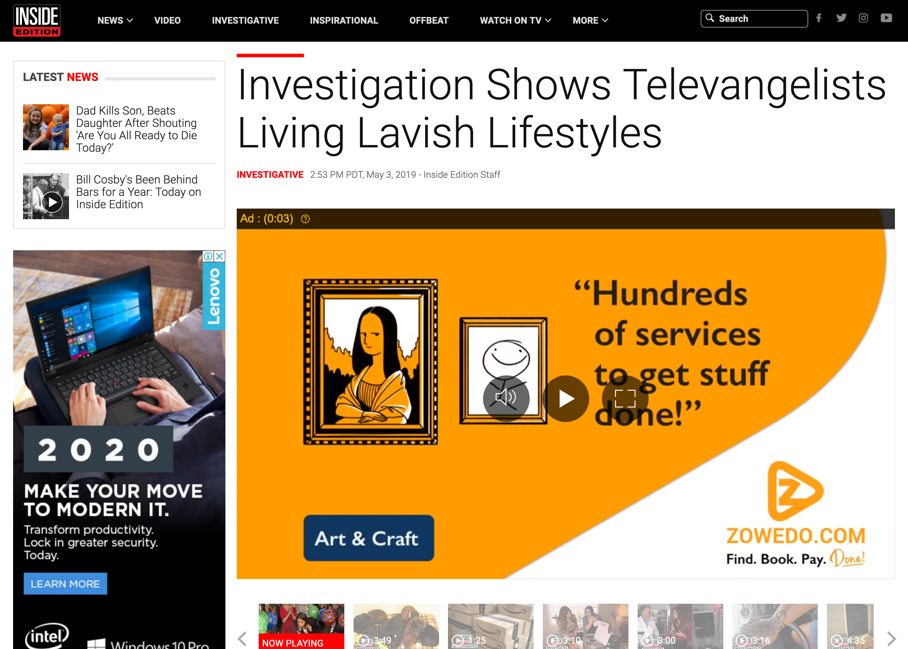
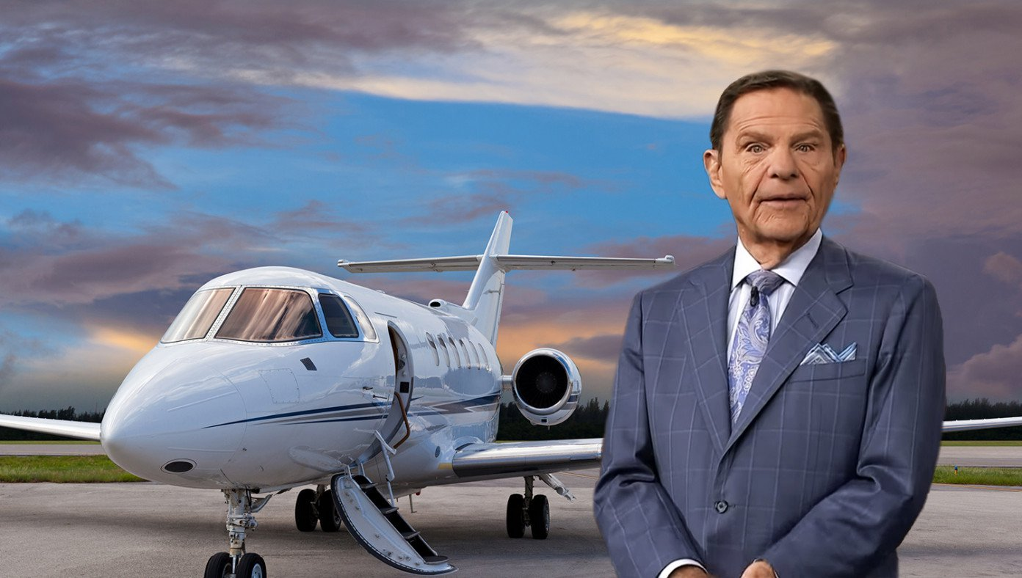
Investigation Shows Televangelists Living Lavish Lifestyle
Notes:
Kenneth Copeland owns TWO private jets and has his own airport at his home in Texas!
Watch the 4-minute clip below
______
https://www.insideedition.com/investigation-shows-televangelists-living-lavish-lifestyles-52662

Slide 9
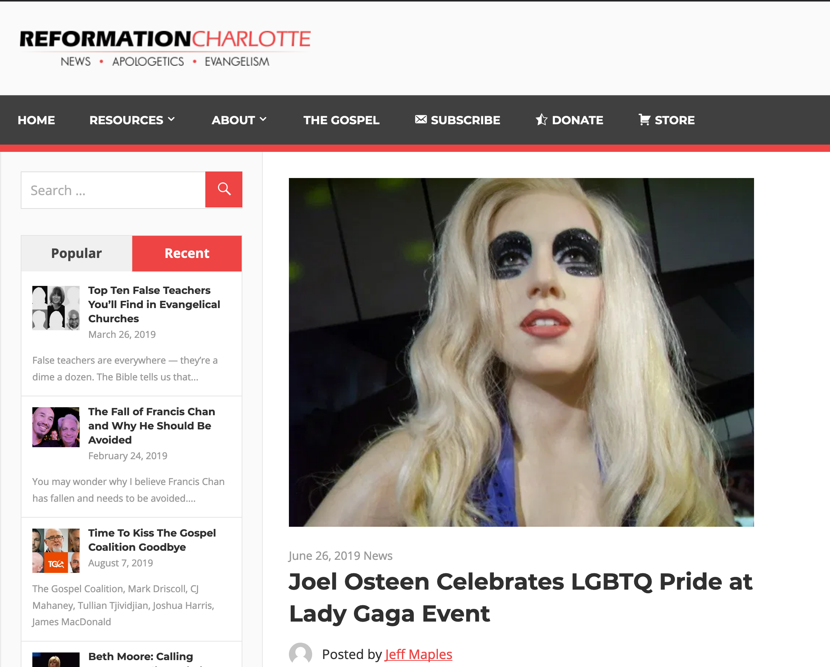
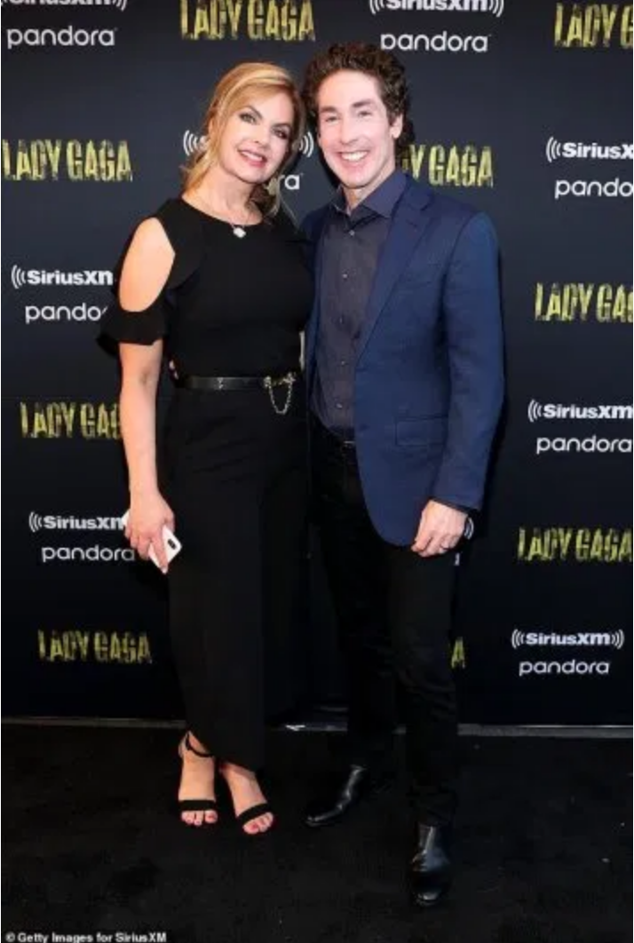
Joel Osteen Celebrates LGBTQ Pride at Lady Gaga Event
Notes:
Therefore go out from their midst, and be separate from them, says the Lord, and touch no unclean thing; then I will welcome you…
2 Corinthians 6:17
This is not satire, this really happened. Joel Osteen, one of the modern-day princes of the Word of Faith prosperity gospel movement, was seen at Lady Gaga’s pride celebration at Apollo Theater on Monday night. The New York Daily News reports,
Poehler wasn’t the only heavy hitter in the crowd. From Alaska Thunderf–k, a drag performer who won Season 2 of “RuPaul’s Drag Race All Stars” to the controversial televangelist and anti-LGBTQ pastor Joel Osteen, the event drew an eclectic mix of fans, industry insiders and celebrities, from the movies (Catherine Zeta-Jones, Michael Douglas), the music universe (Clive Davis, Adam Lambert), the fashion world (Alexander Wang), television (John Oliver, Camila Mendes) and the America’s gay Royal couple and Harlem residents Neil Patrick Harris and husband David Burtka.
Osteen’s presence was curious, because Gaga has championed LGBTQ causes.
Lady Gaga is known for her risque performances and lack of modest attire. Being that Osteen is a charlatan who has been given over to the lusts of this world and bilks millions of people for every dime they have, it comes as no surprise that he and his wife, Victoria, would immerse themselves in the culture of demonic influence, sex, and greed. It was reported that Osteen was wearing a blue blazer while his wife was wearing a long, black dress. A picture of the two can be seen here.
Interestingly, Osteen asserted a few years ago that he believes that the Scriptures are clear that homosexuality is a sin. Yet, he has continuously softened his tone and downplayed the significance toward homosexuality since then. In an effort to remain culturally relevant and inclusive, Osteen generally avoids the topic altogether.
Osteen’s ministry has produced a number of look-alike worldly money-hungry pastors, including his very own apprentice, John Gray, who was caught cheating on his wife and made amends to her by buying her a $200 thousand Lamborghini while living in a $1.8 million home paid for by his church.
________________
https://reformationcharlotte.org/2019/06/26/joel-osteen-celebrates-lgbtq-pride-at-lady-gaga-event/

Slide 10

How can you persevere amidst apostasy?
2 Timothy
Notes:
Will you be walking with Jesus ten years from now?
What should you do now to make sure you are faithful then?
What can you do now to make sure you are following the Lord faithfully in the future?

Slide 11
Overview of Paul's Letters
38
124
39-41
"To the remotest part of the earth" (Acts 1:8)
Acts 9 13 14 15 16 18 21 27 28
Apr 48-
Sep 49
1
Galatia
Apr 50-
Sep 52
2
Aegean
Spr 53-
May 57
3
Asia
Feb 60-
Mar 62
1
Rome
Spr 62-
Fall 67
4
Spain
Aut 67-
Spr 68
2
Rome
Summer 35-
37
Damascus
Antioch
May 57-
Aug 59
Trials
Fall 49
The
Council
Spring 68
Expansion of Church
35 48 49 50 52 53 57 60 62 67 68 95
Matt
Luke
Acts
Mark
John
Gal
1 Thess
1 Cor
Eph
1 Tim
2 Tim
2 Thess
2 Cor
Col
Titus
Missionary
Pastoral
Romans
Philem
Gospels & Acts
Phil
Pauline Epistles
1234
Journeys
Prison
Rome
Imprisonments
Pauline
Notes:
We may suppose that it takes a long time for heresies to develop, but the New Testament teaches otherwise. Within a generation of Christ's life, many false systems developed. Paul writes in the AD 60s just prior to his beheading that many had fallen into the snare of deceptive teaching.

Slide 12
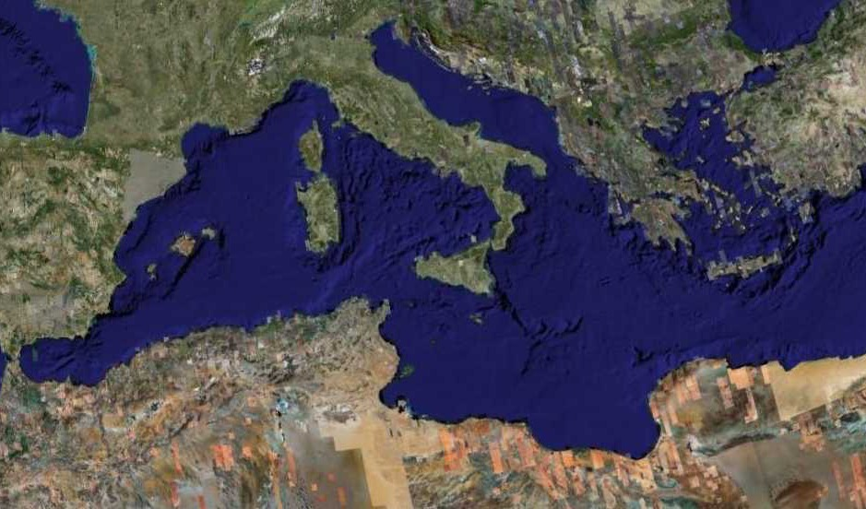
Fourth Missions Trip
1-2 Timothy & Titus After Acts
Spring 62 – Fall 67
Notes:
Paul had finished reaching the Eastern Roman Empire by the time he wrote Titus—and even had just returned from Spain. Yet he soon was captured and brought to Rome a second time, where he wrote 2 Timothy.
—————
Freedom from Imprisonment Spring 62–Fall 67
Paul in Ephesus and Colosse (Timothy left at Ephesus) Spring–Summer 62
Peter travels to Rome 62
Paul in Macedonia late summer 62-winter 62/63
1 Timothy written from Macedonia to Timothy in Ephesus Fall 62
Paul in Asia Minor Spring 63-Spring 64
Paul in Spain (anticipated in Rom. 15:24) Spring 64-Spring 66
Christians persecuted by Nero; Peter martyred Summer 64
Paul in Crete (Titus left there; Tit 1:5) early Summer 66
Paul in Asia Minor Summer- Fall 66
Titus written from Asia Minor to Titus in Crete Summer 66
Paul in Nicopolis (Tit 3:12) Winter 66/67
Paul in Troas (2 Tim 4:13), Macedonia and Greece Spring– Fall 67
Second Roman Imprisonment Fall 67–Spring 68
Paul arrested and brought to Rome Fall 67
2 Timothy written from Rome to Timothy in Ephesus Fall 67
Paul beheaded Spring 68

Slide 13
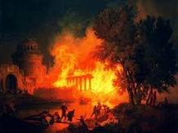
Contrasting the Roman Imprisonments
38
124
39-41
Feb 60-
Mar 62
1
Rome
Spr 62-
Fall 67
4
Spain
Aut 67-
Spr 68
2
Rome
60 62 67 68
Eph
2 Tim
Col
Philem
Phil
Pauline Epistles
1234
Journeys
Rome
Imprisonments
Notes:
What had changed between Pauls’ two imprisonments in Rome? Much! One key event was the Great Fire at Rome in July AD 64.

Slide 14
Contrasting the Roman Imprisonments
38
124
39-41
Feb 60-
Mar 62
1
Rome
Spr 62-
Fall 67
4
Spain
Aut 67-
Spr 68
2
Rome
60 62 67 68
Nero's Mental Health
Stable
Insane
AD 64 Fire of Rome
Before
After
View of Christians
Jewish Sect
Mostly Gentiles
Tolerance by Rome
Protected
No restraints
Persecution by Rome
Infrequent
Widespread
Result for Paul
Released
Beheaded
Notes:
You can see that all legal protections for Christians were removed by the time Paul returned to Rome’s prison system a second time.

Slide 15
Second Roman Imprisonment (AD 67-68)
"As you know, everyone from the province of Asia has deserted me—even Phygelus and Hermogenes" (2 Tim. 1:15 NLT)
"Yes, and everyone who wants to live a godly life in Christ Jesus will suffer persecution. ¹³But evil people and impostors will flourish. They will deceive others and will themselves be deceived" (2 Tim. 3:12-13 NLT)
Notes:
Seven years later the first imprisonment under house arrest, the situation was entirely different. Nero had initiated a persecution of believers and it was very unpopular to be a Christian. May had denied the faith and most had gone underground to the catacombs if they still continued in the faith.

Slide 16
Friends of Paul’s Second Roman Imprisonment (AD 67-68)
"Timothy, please come as soon as you can. ¹⁰Demas has deserted me because he loves the things of this life and has gone to Thessalonica. Crescens has gone to Galatia, and Titus has gone to Dalmatia. ¹¹Only Luke is with me. Bring Mark with you when you come, for he will be helpful to me in my ministry. ¹²I sent Tychicus to Ephesus. ¹³When you come, be sure to bring the coat I left with Carpus at Troas. Also bring my books, and especially my papers. ¹⁴Alexander the coppersmith did me much harm, but the Lord will judge him for what he has done. ¹⁵Be careful of him, for he fought against everything we said" (2 Tim. 4:9-15 NLT).
Notes:
Life was lonely for a very relational man like Paul at this point. Most of his friends had either escaped Rome or fallen away from the Faith.

Slide 17
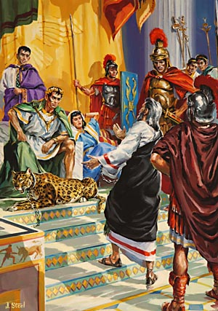
Paul's Second Imprisonment (AD 67-68)
"The first time I was brought before the judge, no one came with me. Everyone abandoned me. May it not be counted against them. ¹⁷But the Lord stood with me and gave me strength so that I might preach the Good News in its entirety for all the Gentiles to hear. And he rescued me from certain death"
(2 Tim. 4:16-17 NLT).
Notes:
Serving Jesus includes times when we feel like no one else is with us in terms of their presence and prayers. But Jesus remains, despite the failures of people.

Slide 18
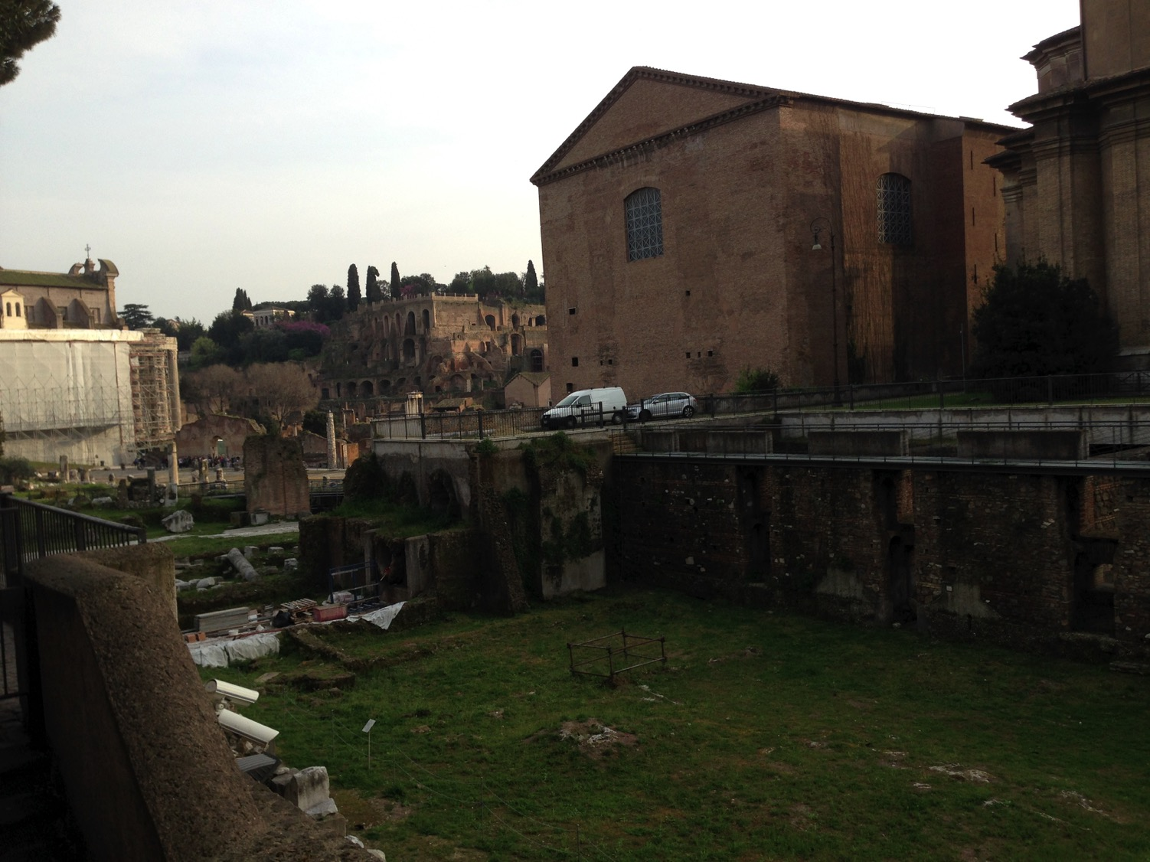
Close Locations!
Mamertine Prison
Curia (Senate "Court")
Notes:
I wonder if Paul knew that Caesar was just across the street!

Slide 19
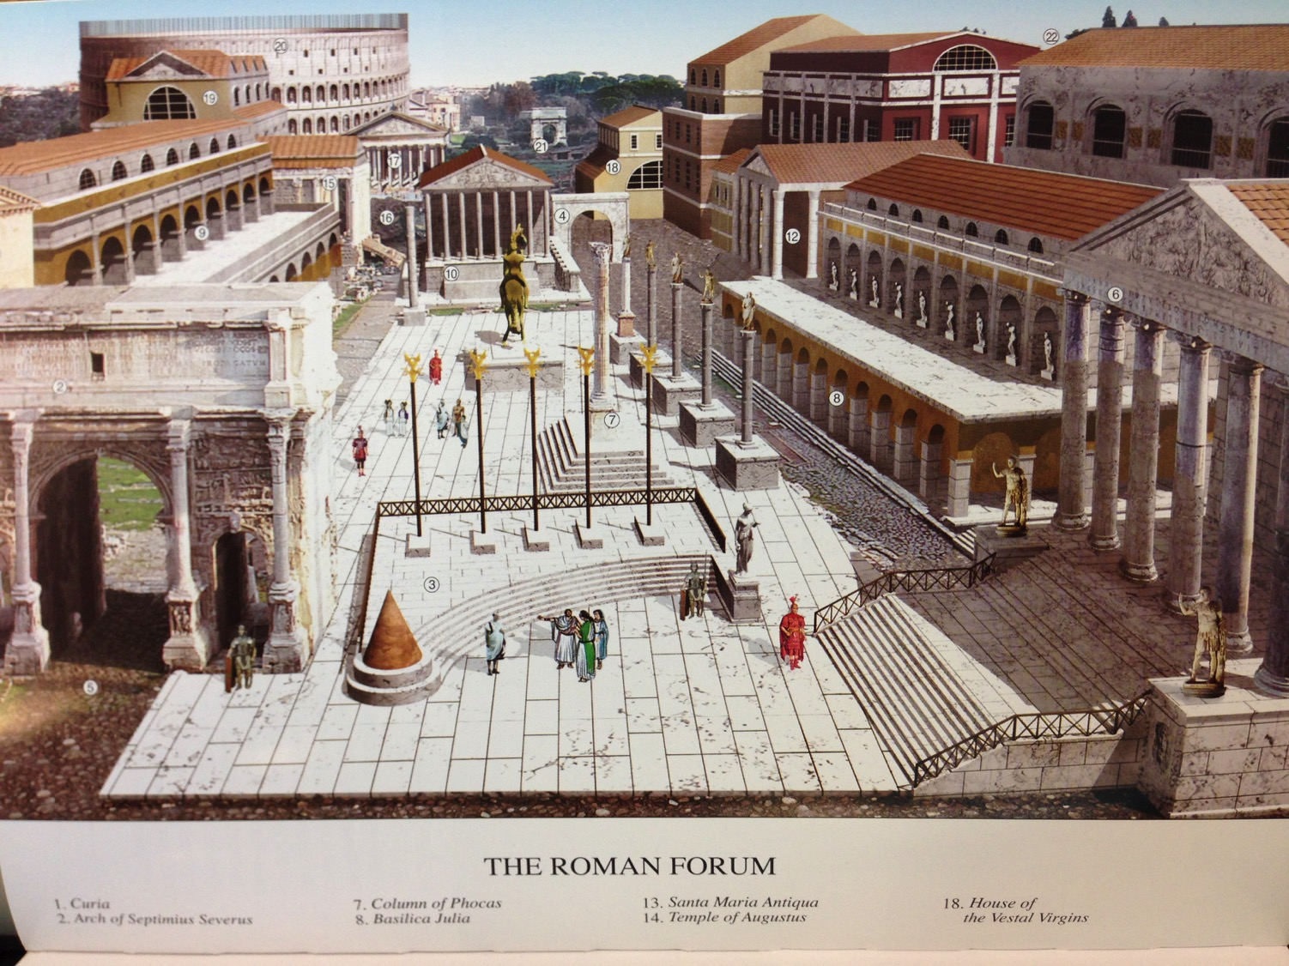
View of the Forum from the Mamertine Prison (AD 4th cent.)
Notes:
The Forum was filled with buildings and monuments honoring the emperors and generals who expanded the Empire. In AD 80, the Coliseum was completed and can be seen in the rear left. It was funded by the gold seized from burning Herod’s temple in Jerusalem.

Slide 20
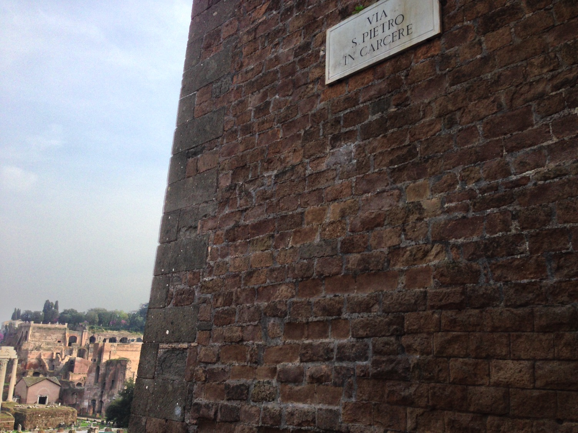
"Peter in Prison Street"
Notes:
Honestly, Susan and I had a very difficult time finding the prison where Paul was held. It wasn’t on any of the tourist maps! Yet, finally, we found it on “Peter in Prison Street”!

Slide 21
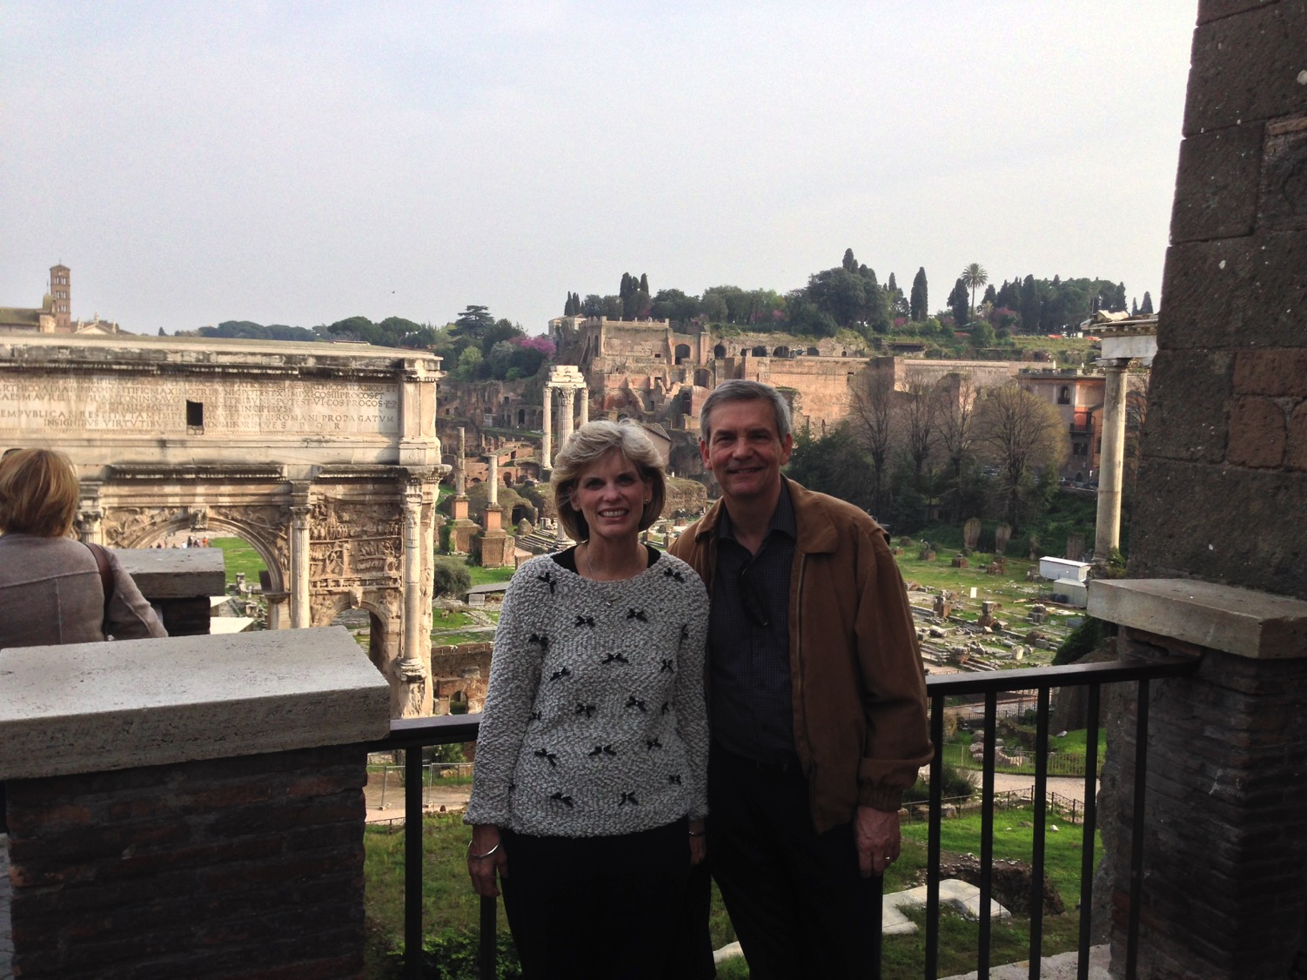
Susan & Rick free because of Peter's & Paul's imprisonment
Notes:
The thought struck me that I could be free to visit the place 2000 years after Paul lost his freedom on this street. He even lost his life.

Slide 22
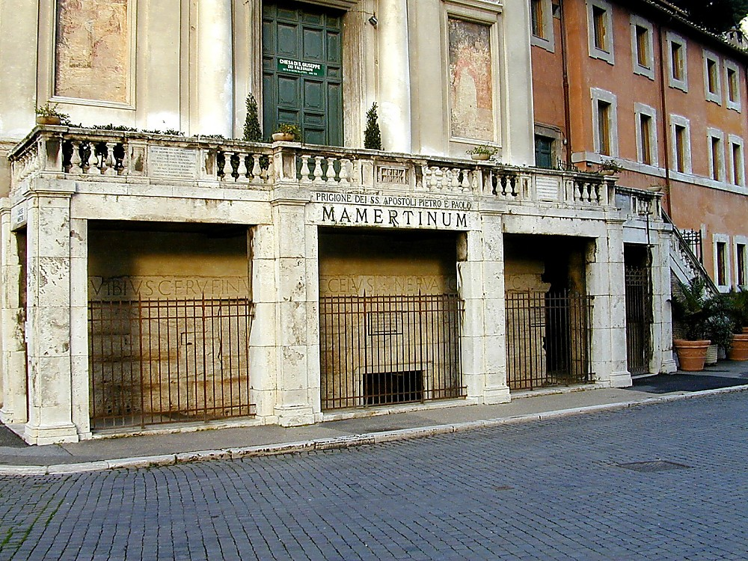

"Mamertine Prison of the Apostles Peter & Paul"
Notes:
Tourists can visit the prison for a small sum—if you can find it!
—Todd Bolen, BiblePlaces.com

Slide 23
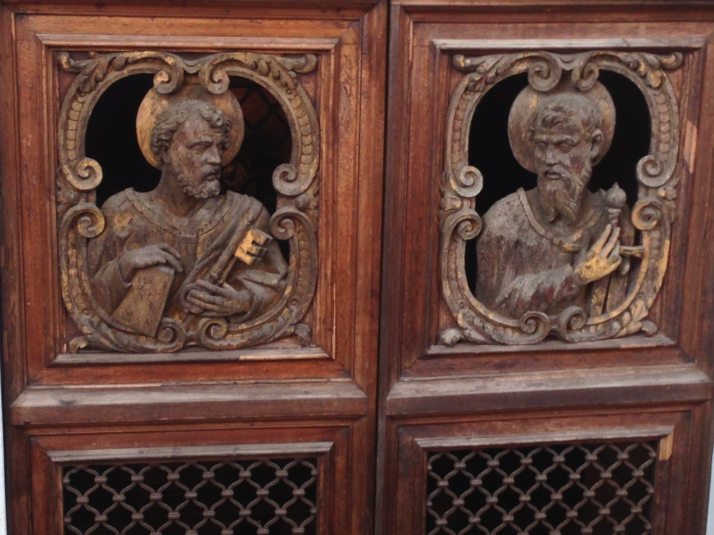
Mamertine Doors Depict Peter & Paul
Notes:
Both went through doors like this (AD 64 for Peter, AD 67 for Paul).

Slide 24
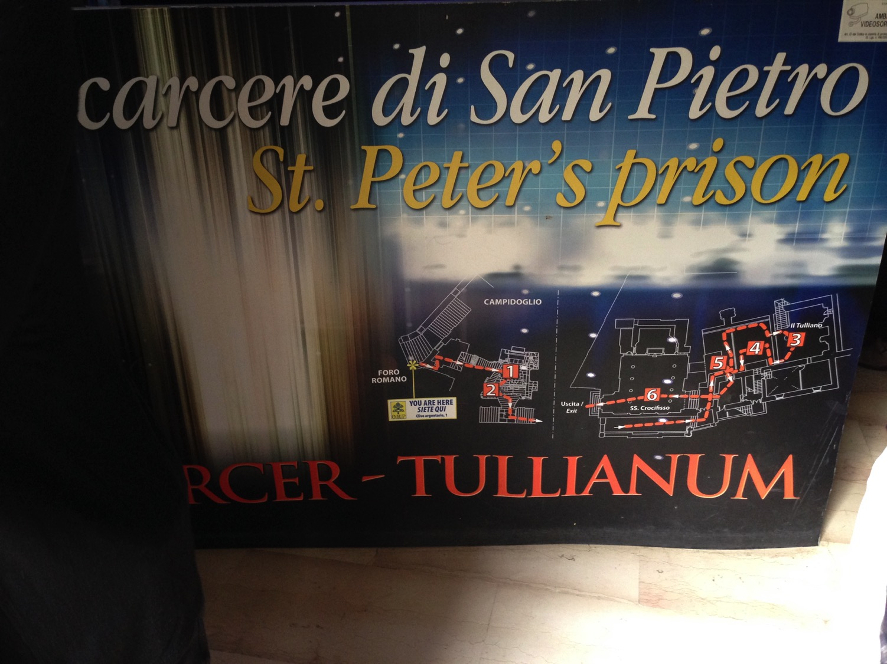
The Mamertine Tour
Notes:
Given Peter’s stature as supposedly the first Pope there in Rome, he is given priority over Paul.

Slide 25
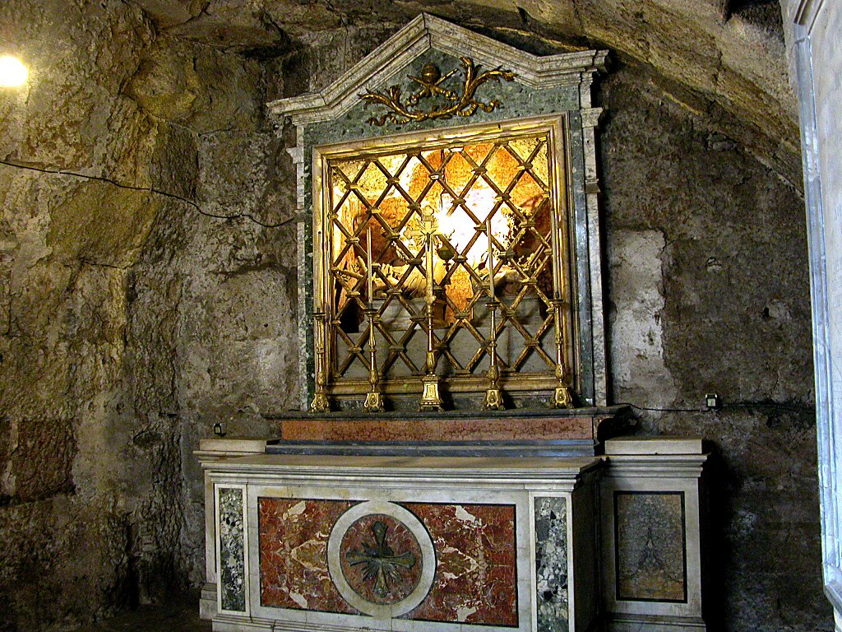
The Upper Mamertine room busts of Peter and Paul
Notes:
At the ground level is an altar to these great apostles. Yet they had little time at this level, for they were lowered into a hole in the floor and kep below.

Slide 26
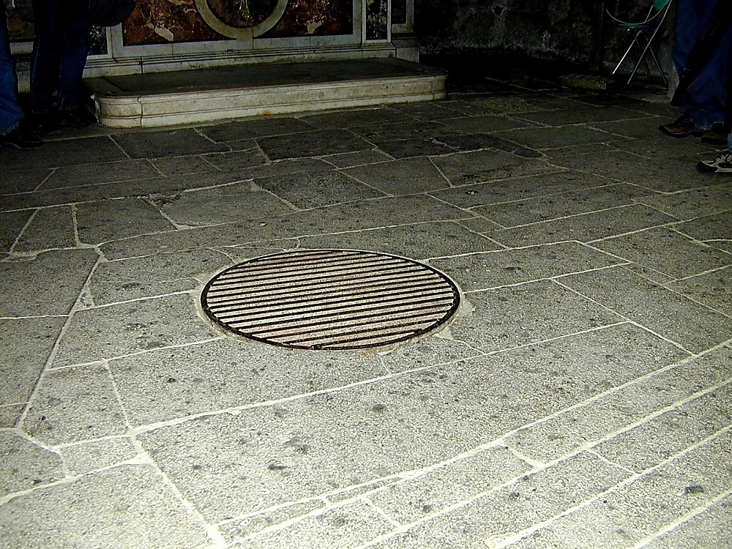
Prisoners were lowered through the manhole into the former cistern below
Notes:
The Carcer was the only prison in ancient Rome. It had two sections, an upper and a lower; the upper was known as the "Carcer" proper, while the lower (originally thought to have been a cistern) was known as the "Tullianum." Those prisoners that entered the Tullianum from the Carcer were lowered through a hole in the Carcer's floor. The name "Tullianum" is probably derived from the Latin word for a spring of water, and incidentally, this section of the prison does, in fact, house a well. According to tradition, the Apostle Peter caused the well-water to spring up so that he might baptize his jailors, St. Processus and St. Martinianus. It is debated whether Peter was actually incarcerated here. —Todd Bolen, BiblePlaces.com

Slide 27
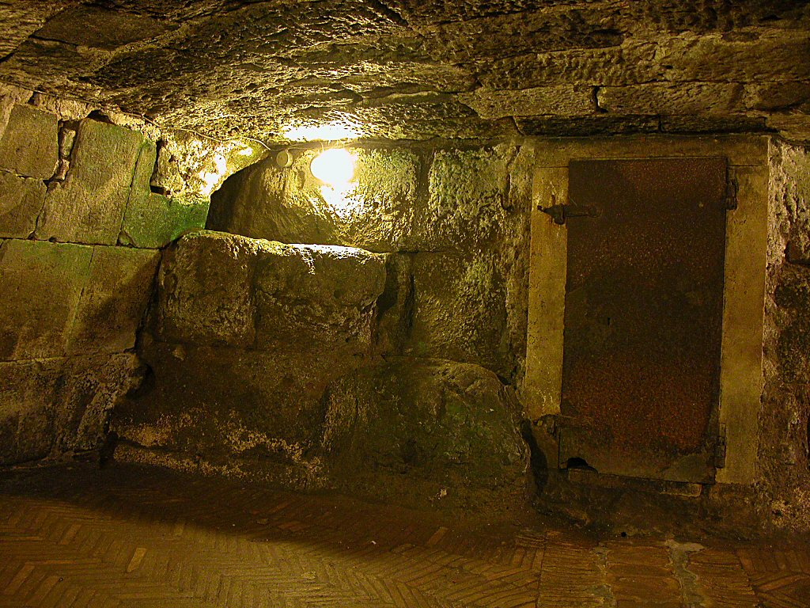
Mamertine Prison writing area and door
Mamertine Prison writing area and door
Notes:
The state rarely incarcerated common criminals but kept the Mamertine Prison for political prisoners doomed for execution by being thrown off the Tarpeian Rock. Enemies of the State, such as Jugurtha and Vercingetorix, were often strangled in the Tullianum. Sallust, a Roman writer in 40 B.C., described the Tullianum as "about twelve feet deep, closed all round by strong walls and a stone vault. Its aspect is repugnant and fearsome from its neglect, darkness, and stench."
—Todd Bolen, BiblePlaces.com

Slide 28
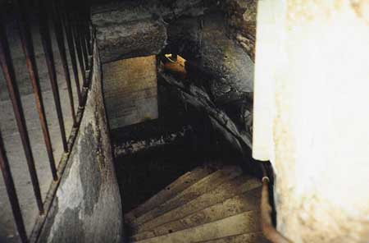
Down the Steps
Notes:
Now steps have been added so people like me and you can descend into the lower level that Paul had to enter via the hole.

Slide 29
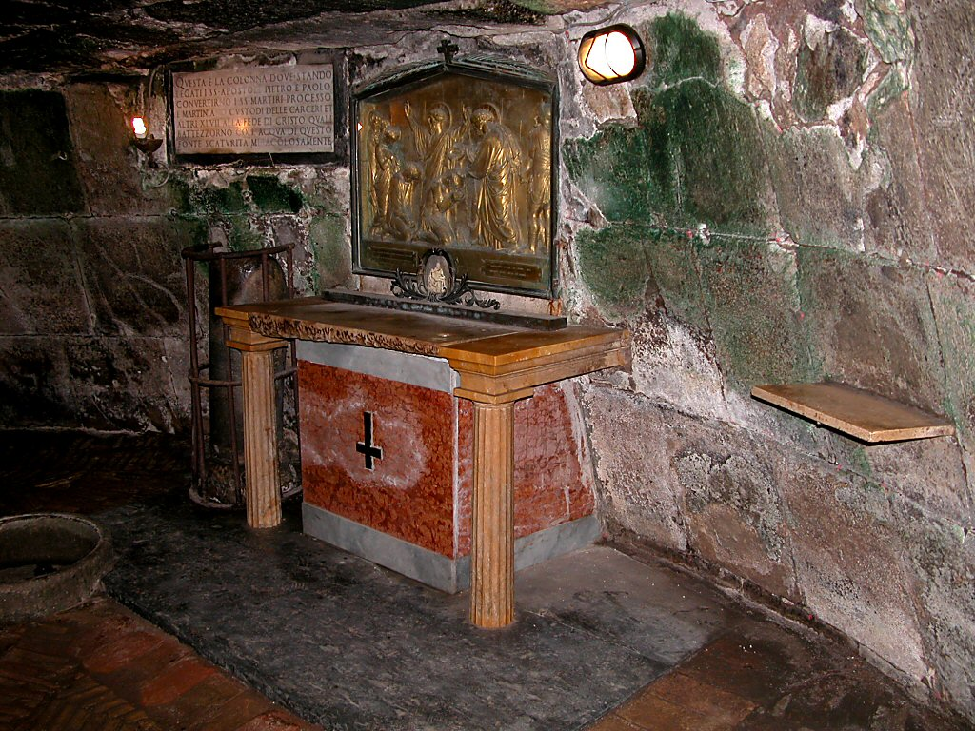
Peter's (AD 64) & Paul's (AD 67-68) Cell Below
Notes:
When told that he would die by crucifixion, Peter felt he was not worthy to die by the same means as Jesus. He requested to be crucified upside down, and the Romans obliged. The altar recalls this with an upside down cross.

Slide 30
How can you persevere amidst apostasy?
2 ways…
2 Timothy
Notes:
What can you do now to make sure you are following the Lord faithfully in the future?

Slide 31
How to hang in there:
Faithfully...
Obey God’s Word
2 Timothy 1–2
Notes:
Consistently follow what God says (1-2)

Slide 32
Slides on
2 Timothy 1

Slide 33
Paul greeted Timothy with his own persevering attitude in the face of death (1:1-2).

Slide 34
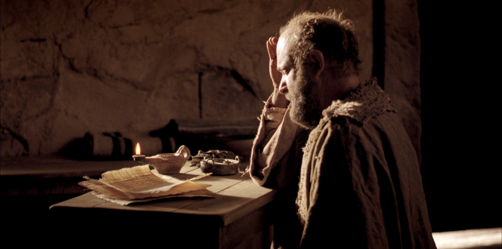
"This letter is from Paul, chosen by the will of God to be an apostle of Christ Jesus. I have been sent out to tell others about the life he has promised through faith in Christ Jesus"
(2 Timothy 1:1 NLT).

Slide 35
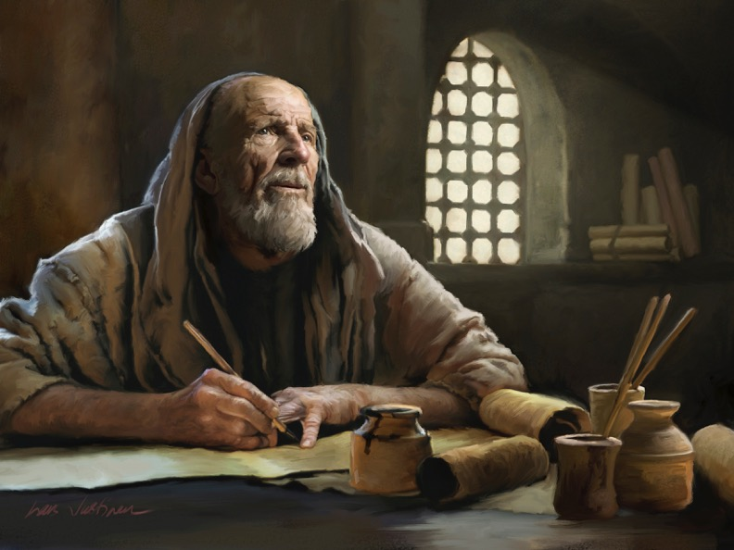
"I am writing to Timothy, my dear son. May God the Father and Christ Jesus our Lord give you grace, mercy, and peace"
(2 Timothy 1:2 NLT).

Slide 36
Timothy should imitate others’ faithfulness despite many who fell away (1:3-18).

Slide 37
He learned faithfulness from his mother and grandmother shown at his ordination (1:3-7).

Slide 38
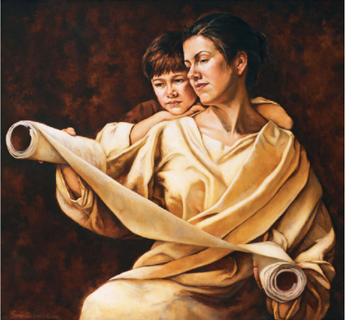
MAJOR THEME 1: Faithfulness
2 Timothy
Examples of Faithfulness:
Learned from mother Eunice & grandmother Lois (1:3-7)
Timothy learned in his own mixed-parentage home, with the women in his life setting the example of faithfulness in daily dealings.

Slide 39
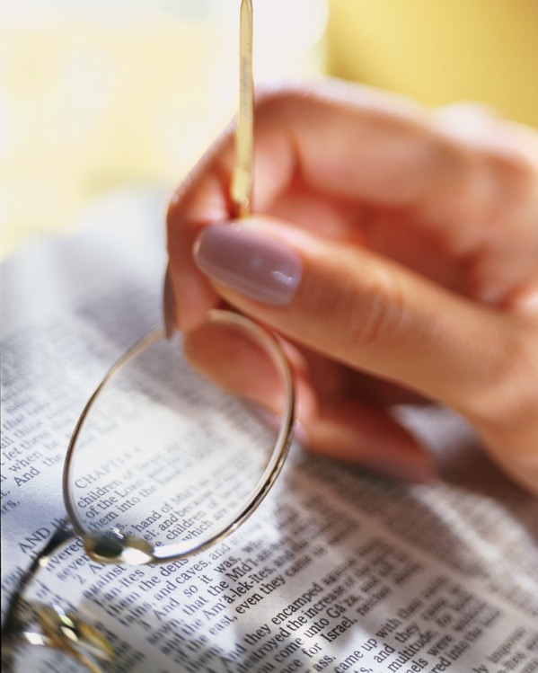
MAJOR THEME 1: Faithfulness
2 Timothy
b. Learned from Paul (1:8-14)
Paul remained faithful in difficult times because he believed and trusted God to keep him till the end (1:11-12).

Slide 40
He should bravely suffer Nero’s tortures like Paul through the gospel’s power (1:8-14).

Slide 41
"So never be ashamed to tell others about our Lord. And don’t be ashamed of me, either, even though I’m in prison for him. With the strength God gives you, be ready to suffer with me for the sake of the Good News.
⁹ For God saved us and called us to live a holy life. He did this, not because we deserved it, but because that was his plan from before the beginning of time—to show us his grace through Christ Jesus"
(2 Timothy 1:8-9 NLT).

Slide 42
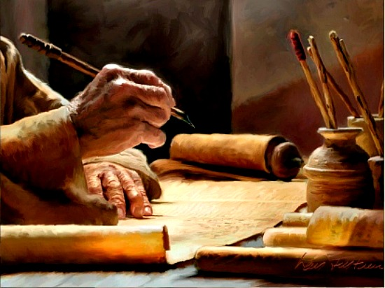
"That is why I am suffering here in prison. But I am not ashamed of it, for I know the one in whom I trust, and I am sure that he is able to guard what I have entrusted to him until the day of his return" (2 Timothy 1:12 NLT).

Slide 43
Asian believers deserted Jesus but Onesiphorus set a faithful example (1:15-18).

Slide 44
Second Roman Imprisonment (AD 67-68)
"As you know, everyone from the province of Asia has deserted me—even Phygelus and Hermogenes" (2 Tim. 1:15 NLT)
Notes:
Seven years later the first imprisonment under house arrest, the situation was entirely different. Nero had initiated a persecution of believers and it was very unpopular to be a Christian. May had denied the faith and most had gone underground to the catacombs if they still continued in the faith.

Slide 45
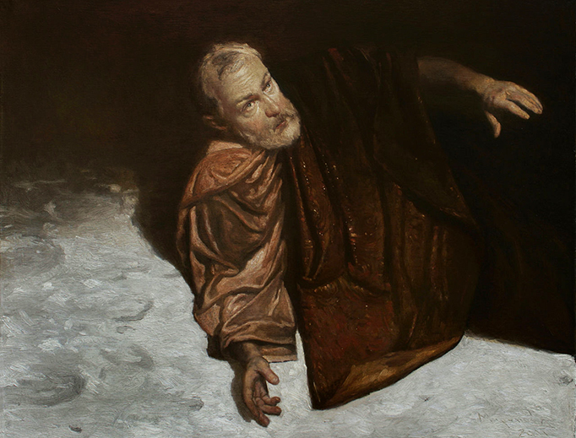
MAJOR THEME 1: Faithfulness
2 Timothy
  c. Learned from Onesiphorus (1:15-18)
  Onesiphorus was not ashamed to be known as a friend of Paul when he was a prisoner. He searched for Paul very diligently and found him.

Slide 46
Slides on
2 Timothy 2

Slide 47
Knowing what faithfulness looks like helps us persevere under trial (2 Tim 2).

Slide 48
Like a discipling teacher, invest in others the teaching you received (2:1-2).

Slide 49



Multiply Yourself into Trustworthy Men!
"You have heard me teach things that have been confirmed by many reliable witnesses. Now teach these truths to other trustworthy people who will be able to pass them on to others" (2 Tim. 2:2 NLT).
Discipleship
Paul
Timothy
Reliable Men
Others
Notes:
Get mentored by godly people (2 Tim. 2:2).

Slide 50

Levels of Discipleship
Mentor (Paul)
Peer
Peer (Timothy)
Mentored (Others)
Notes:
Each of us should be like Timothy to learn from someone more mature than us, and also be a "Paul" to someone less mature to help that person grow in Christ.

Slide 51

Life Transformation Groups
The Commitment: Meet one hour a week with 1-2 others of the same sex to provide accountability in 3 areas
Confess sin around 10 questions
Read 3 Bible chapters daily
Pray for lost friends
Church Multiplication Associates––www.CMAResources.org
Notes:
How can you mentor and get mentored? Life Transformation Groups are 2-3 people meeting weekly for accountability.
An LTG has 2-3 persons committed to growing spiritually. They meet in a home, restaurant, church, business, or wherever they can have a 60-minute accountability session each week.

Slide 52
Like a good soldier, show unswerving commitment to please your superior, Jesus
(2:3-4).

Slide 53
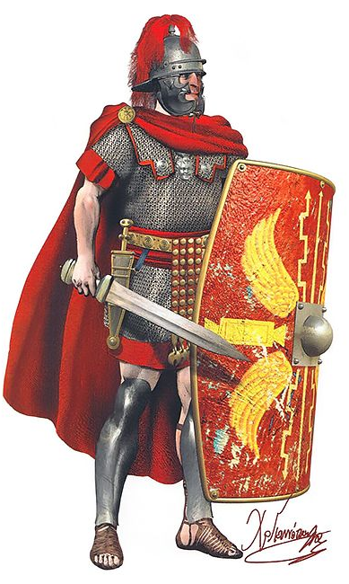
"Endure suffering along with me, as a good soldier of Christ Jesus. ⁴ Soldiers don’t get tied up in the affairs of civilian life, for then they cannot please the officer who enlisted them"
(2 Timothy 2:3-4 NLT).

Slide 54
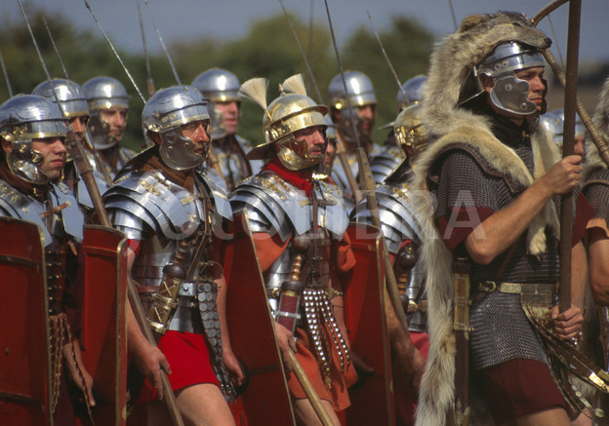
Roman Soldiers

Slide 55
Like a successful athlete, obey the rules in God's Word (2:5).

Slide 56
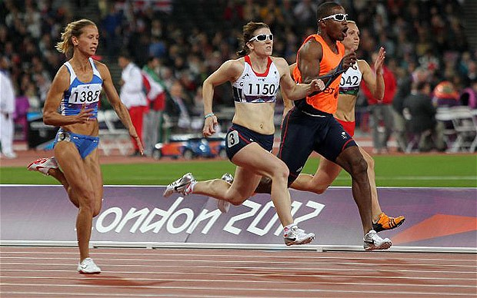
Characteristics of Faithfulness
2 Timothy
  2. Athlete (2:5) – An athlete has to follow the rules to win the race.
Notes:
Like a successful athlete, obey the rules in God's Word (2:5).
One of those rules historically has been that men cannot compete in women's sports—even if they claim to be a woman. But no longer…

Slide 57
Like a diligent farmer, have the joy of spiritual fruit like Jesus after he was raised (2:6-13).

Slide 58
Characteristics of Faithfulness
2 Timothy
  3. Farmer (2:6-13) – A farmer must work hard
  to achieve a good harvest.
Faithfulness = loyal to Christ, our commander,
to follow the law of God and work hard

Slide 59

2 Timothy 2:11–13 (NIV)
¹¹ Here is a trustworthy saying:
If we died with him,
we will also live with him;
¹² if we endure,
we will also reign with him.
If we disown him, he will also disown us;
¹³ if we are faithless, he remains faithful, for he cannot disown himself.

Slide 60
Like an unashamed workman, fight heresy with Scripture—not human words (2:14-19).

Slide 61

2 TIMOTHY 2:15
DO YOUR BEST TO PRESENT YOURSELF TO
GOD
AS ONE APPROVED
A WORKER
WHO HAS NO NEED
TO BE ASHAMED
RIGHTLY HANDLING
THE WORD OF
TRUTH

Slide 62
How can you persevere amidst apostasy?
2 Timothy
Notes:
What can you do now to make sure you are following the Lord faithfully in the future?

Slide 63
How to hang in there:
Faithfully...
Obey God’s Word
Preach God’s Word
&
2 Timothy 1–2
2 Timothy 3–4
Notes:
Consistently follow what God says (1-2)
Consistently tell others what God says (3-4)

Slide 64
Slides on
2 Timothy 3

Slide 65
Before Jesus returns, avoid false teachers who are smooth-tongued but godless (3:1-9).

Slide 66
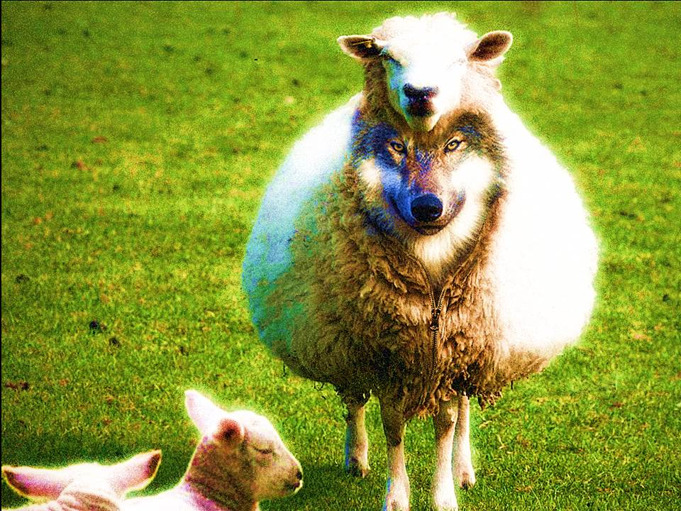
Avoid godless teachers (3:1-9).
Notes:
How else can we deal with heretics besides avoiding them? What are those efforts that will last? Paul says, "But you…" in verse 10 to give us what to do instead of following godless teachers. We can deal with secularism when we…

Slide 67
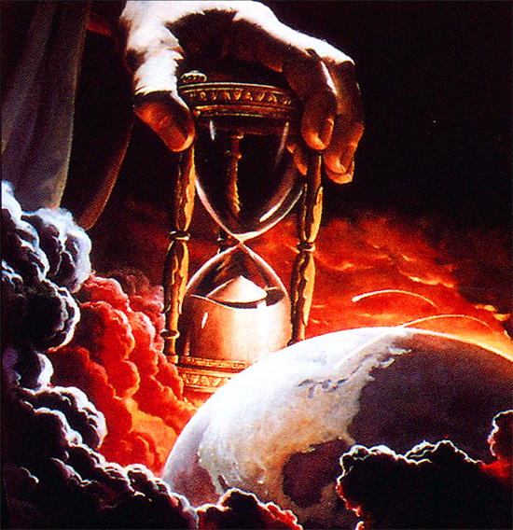
"You should know this, Timothy, that in the last days there will be very difficult times"
(3:1 NLT).
Notes:
We are promised difficulty (3:1).
Paul was experiencing great trials when he wrote this.

Slide 68
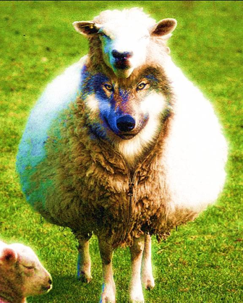
19 Traits of Apostates (3:1-5)
2 Timothy
lovers of themselves
lovers of money
boastful
proud
abusive
disobedient to their parents
ungrateful
unholy
without love
unforgiving
slanderous
without self-control
brutal
not lovers of the good
treacherous
rash
conceited
lovers of pleasure rather than lovers of God
having a form of godliness but denying its power
Notes:
Paul lists 19 characteristics of secular people who actually do not appear so secular, as they have a religious nature about them. It is a very sobering list.
Verses 2-5 give 19 sad traits of people in general.
This is followed by the characteristics of religious leaders in verses 6-9.
Beginning in verses 6-7, "Paul focused on the specific situation in Ephesus. It was from the increasingly large group in society who displayed the preceding characteristics that the false teachers had emerged to plague the church" (BKC).

Slide 69

Avoid godless leaders
"Avoid such men as these"
(2 Timothy 3:5b NAU).
"Stay away from people like that!"
(2 Timothy 3:5b NLT).
Notes:
The advice to us today is often to engage with false teachers. However, Paul's meaning here is to "purposely to avoid associating with someone, turn away from, avoid" (BDAG).

Slide 70
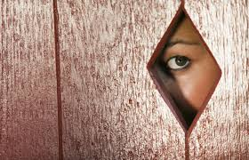
"They are the kind who work [lit. creep] their way into people's homes and win the confidence of vulnerable women who are burdened with the guilt of sin and controlled by various desires. ⁷(Such women are forever following new teachings, but they are never able to understand the truth.)" (2 Timothy 3:6-7 NLT).
Notes:
Heretics are doomed despite their popularity (3:6-9).
Gullible women loved the latest heresy (3:6-7).
(Why is it a waste of time listening to heretics?)

Slide 71
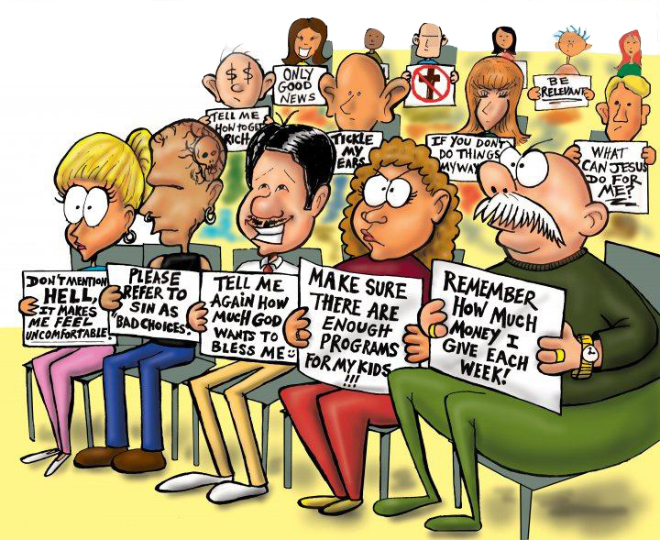
People-Pleasing Preaching

Slide 72
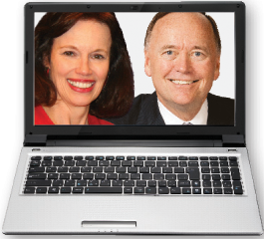
"These teachers oppose the truth just as Jannes and Jambres opposed Moses. They have depraved minds and a counterfeit faith. ⁹But they won't get away with this for long. Someday everyone will recognize what fools they are, just as with Jannes and Jambres" (3:8-9 NLT).
Notes:
Godless teachers are doomed due to their depraved minds that reject truth (3:8-9).
"The reference to Jannes and Jambres and their opposition to Moses draws not on the Old Testament but on a widespread Jewish legend about two of Pharaoh's magicians who competed against Moses and lost (cf. Ex. 7:11; 9:11). The comparison between the false teachers and the Egyptians, and implicitly therefore Timothy and Moses, must have encouraged the young minister" (BKC).
————————
Common Core State Standards in Mathematics, Grades 3–8
In this timely and practical course, Dr. Kanold and Dr. Briars explain both the whys and the how-tos for implementing the CCSS
http://www.solution-tree.com/authors/tim-kanold/ccss-math-3-8-online-course.html

Slide 73
Accept and preach the Word of God as well as fulfill all ministry duties (3:10–4:5).

Slide 74
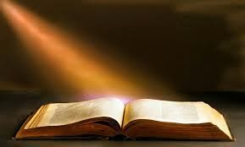
Accept truth (3:10-17).
Notes:
Feed yourself reality from God's servants and God's Word.

Slide 75

a. Follow God's servants (3:10-13)

Slide 76
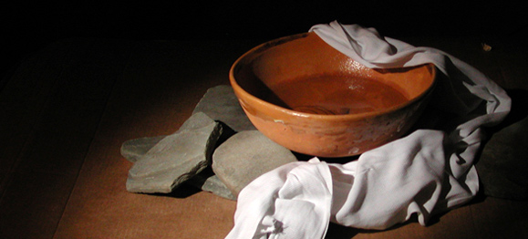
"But you, Timothy, certainly know what I teach, and how I live, and what my purpose in life is. You know my faith, my patience, my love, and my endurance. ¹¹You know how much persecution and suffering I have endured. You know all about how I was persecuted in Antioch, Iconium, and Lystra—but the Lord rescued me from all of it" (2 Timothy
3:10-11 NLT).
Notes:
Follow Paul's example in suffering (3:10-11).
We often say, "Don't follow me. Follow Christ." That sounds humble, but people need to see contemporary examples of Jesus.
Paul said to follow Christ, but he also encouraged his readers to follow him. "Follow me, as I follow Christ" (Eph. 5:1)

Slide 77
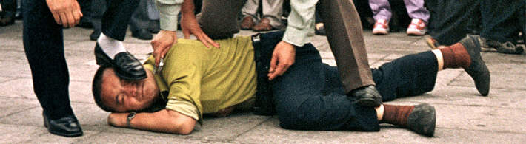
"Yes, and everyone who wants to live a godly life in Christ Jesus will suffer persecution. ¹³But evil people and impostors will flourish. They will deceive others and will themselves be deceived" (2 Timothy 3:12-13 NLT).

Slide 78
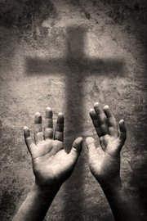
"Yes, and everyone who wants to live a godly life in Christ Jesus will suffer persecution" (2 Timothy 3:12 NLT).
Notes:
This verse seems so incredible to us that we strain at a gnat to explain it away. "Surely that look they gave me is a form of persecution!" we rationalize.
More likely, we are fooling ourselves into thinking that we are really living a godly life.

Slide 79
How can we accept truth instead of lies?
Truth
Lies
Notes:
How can we accept truth instead of lies?

Slide 80
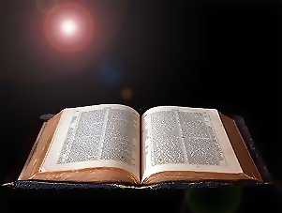
b. Follow God's Word (3:14-17)

Slide 81
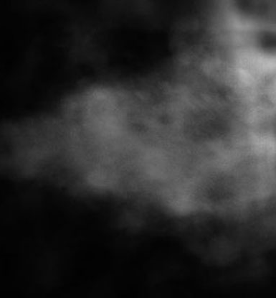
"All Scripture is God-breathed…"
(2 Timothy 3:16a NIV).
Notes:
The Greek word for "inspiration" literally means "God-breathed."

Slide 82
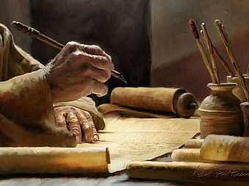
"All Scripture is God-breathed…"
(2 Timothy 3:16a NIV).
Notes:
True, God used people, but his Spirit spoke through them so the Scriptures are without error.

Slide 83

Four Results of God's Word
Rebuking
Correcting
Teaching
Training
(in Righteousness)
2 Timothy 3:16-17
Notes:
If you read sequentially through the Bible, you will have the divine balance in these four areas:
Teaching tells people how to walk God's road
Rebuking tells them when they get off the path
Correcting shows how to get back to the right way
Training in righteousness is the result of the cycle of teaching, rebuking and correcting over and over.

Slide 84
Four Results of God's Word
Rebuking
Correcting
Teaching
Training
(in Righteousness)
2 Timothy 3:16-17
Notes:
If you read sequentially through the Bible, you will have the divine balance in these four areas:
Teaching tells people how to walk God's road
Rebuking tells them when they get off the path
Correcting shows how to get back to the right way
Training in righteousness is the result of the cycle of teaching, rebuking and correcting over and over.

Slide 85
Slides on
2 Timothy 4

Slide 86
Preach and live the truth by hardship, rebuking, encouraging, and evangelizing (4:1-5).

Slide 87
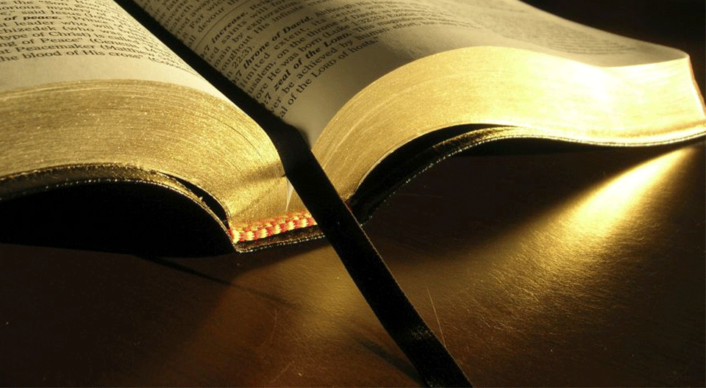
"I solemnly urge you in the presence of God and Christ Jesus, who will someday judge the living and the dead when he appears to set up his Kingdom: ²Preach the word of God. Be prepared, whether the time is favorable or not. Patiently correct, rebuke, and encourage your people with good teaching"
(2 Timothy 4:1-2 NLT).

Slide 88
"For a time is coming when people will no longer listen to sound and wholesome teaching. They will follow their own desires and will look for teachers who will tell them whatever their itching ears want to hear. ⁴ They will reject the truth and chase after myths" (2 Timothy 4:3-4 NLT).
They will “turn away their ears (apostrepho) from the truth"
(2 Timothy 4:4 NAU).

Slide 89
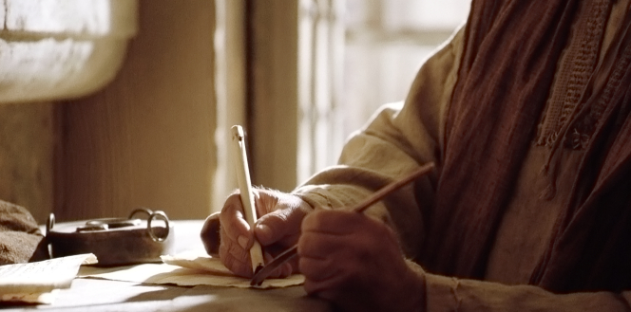
"But you should keep a clear mind in every situation. Don’t be afraid of suffering for the Lord. Work at telling others the Good News, and fully carry out the ministry God has given you" (2 Timothy 4:5 NLT).

Slide 90
Hope in God until death despite betrayals by friends (4:6-18).

Slide 91
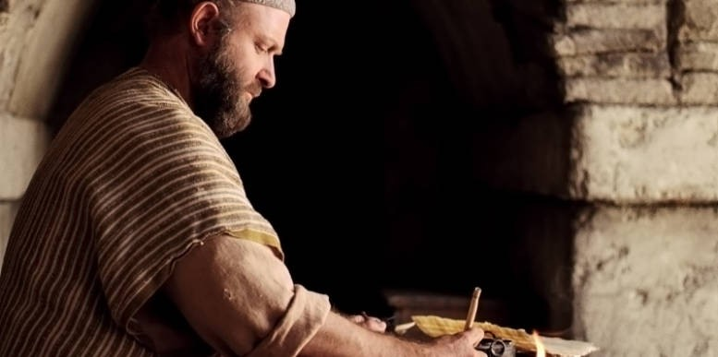
"And now the prize awaits me—the crown of righteousness, which the Lord, the righteous Judge, will give me on the day of his return. And the prize is not just for me but for all who eagerly look forward to his appearing" (2 Timothy 4:8 NLT).

Slide 92
Do not be conquered by death, but victorious in it and relational through every trial (4:19-22).

Slide 93
How can you persevere amidst apostasy?
2 Timothy
Notes:
What can you do now to make sure you are following the Lord faithfully in the future?

Slide 94
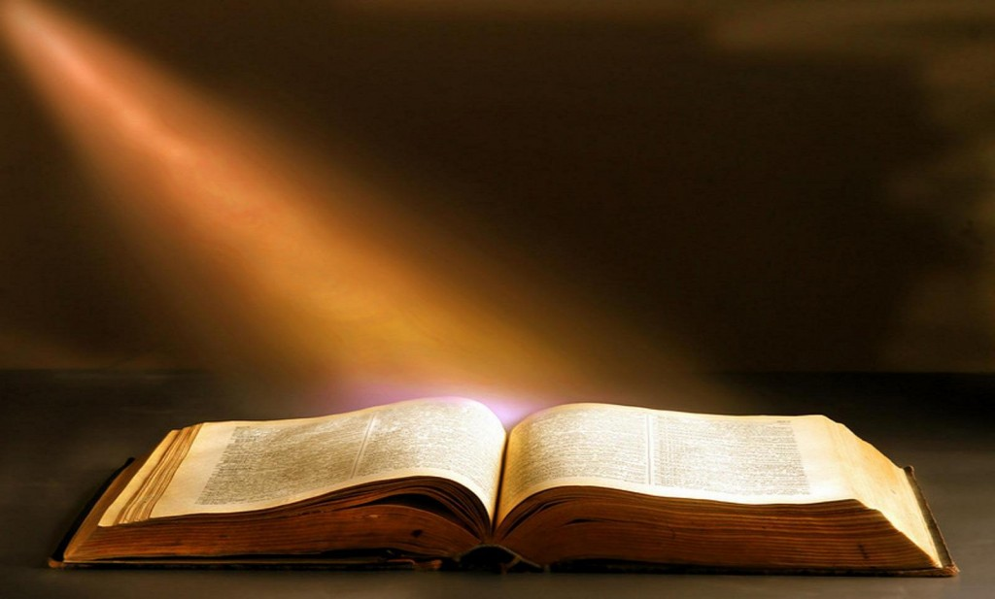
Main Idea
Faithfully obey and preach God’s Word.
2 Timothy

Slide 95
How to hang in there:
Faithfully...
Obey God’s Word
Preach God’s Word
&
2 Timothy 1–2
2 Timothy 3–4
Notes:
Consistently follow what God says (1-2)
Consistently tell others what God says (3-4)

Slide 96
"For a time is coming when people will no longer listen to sound and wholesome teaching. They will follow their own desires and will look for teachers who will tell them whatever their itching ears want to hear. ⁴ They will reject the truth and chase after myths" (2 Timothy 4:3-4 NLT).
They will “turn away their ears (apostrepho) from the truth"
(2 Timothy 4:4 NAU).

Slide 97

Will you be walking with Jesus ten years from now?
What should you do now to make sure you are faithful then?

Slide 98

Does your reading, news, friends, movies, TV, and especially the Internet build your faith or tear it down?

Slide 99
Black

Slide 100


NT Preaching • BibleStudyDownloads.org
Get this presentation and script for free!

